Slide 1
Graph Neural Networks
Karimi Zayan ۰ Jed Lim ۰ Mahir Shah ۰ Kabir Jain (JC students from NUS High)
Notes:
Good morning everyone, I will be presenting on my research project real world implementation and security analysis of structured encryption on amazon-web services. (click)

Slide 2





Who are we?
Mahir Shah
Kabir Jain
Lim Li Xin Jed
Karimi Zayan

Slide 3

Follow me on instagram
@integralzayan

Slide 4
Introduction
Vertex/Nodes
Graphs are mathematical structures which are used to model many relationships
Edge

Slide 5
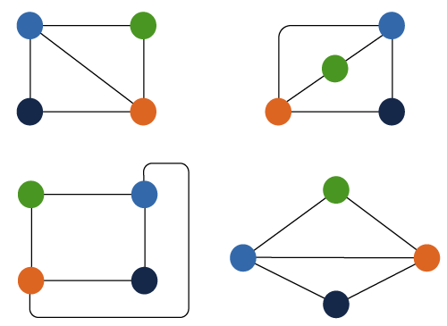
Just connections!

Slide 6
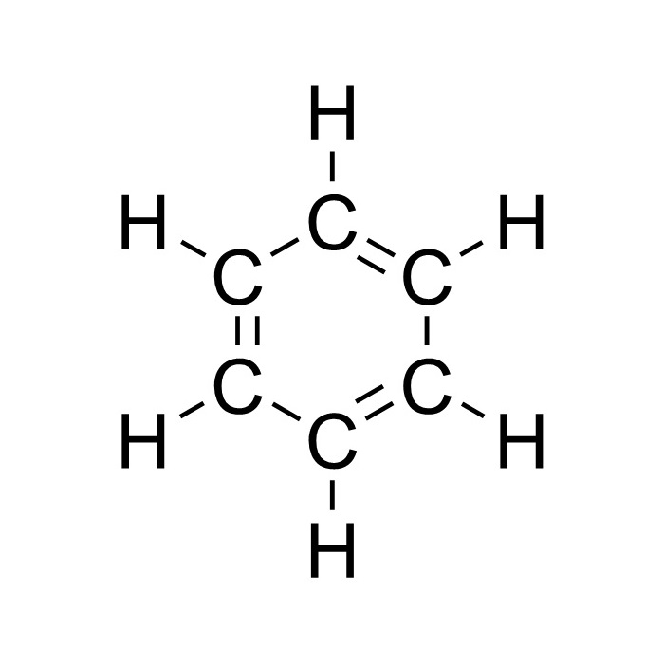
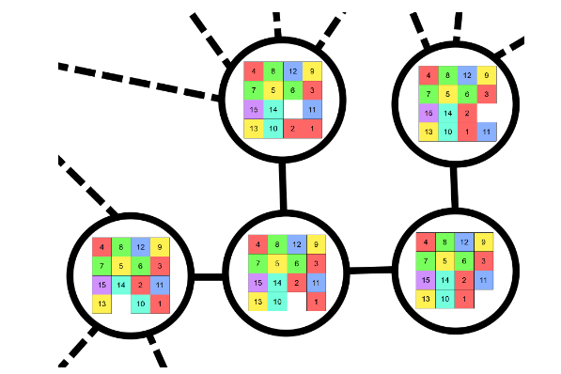
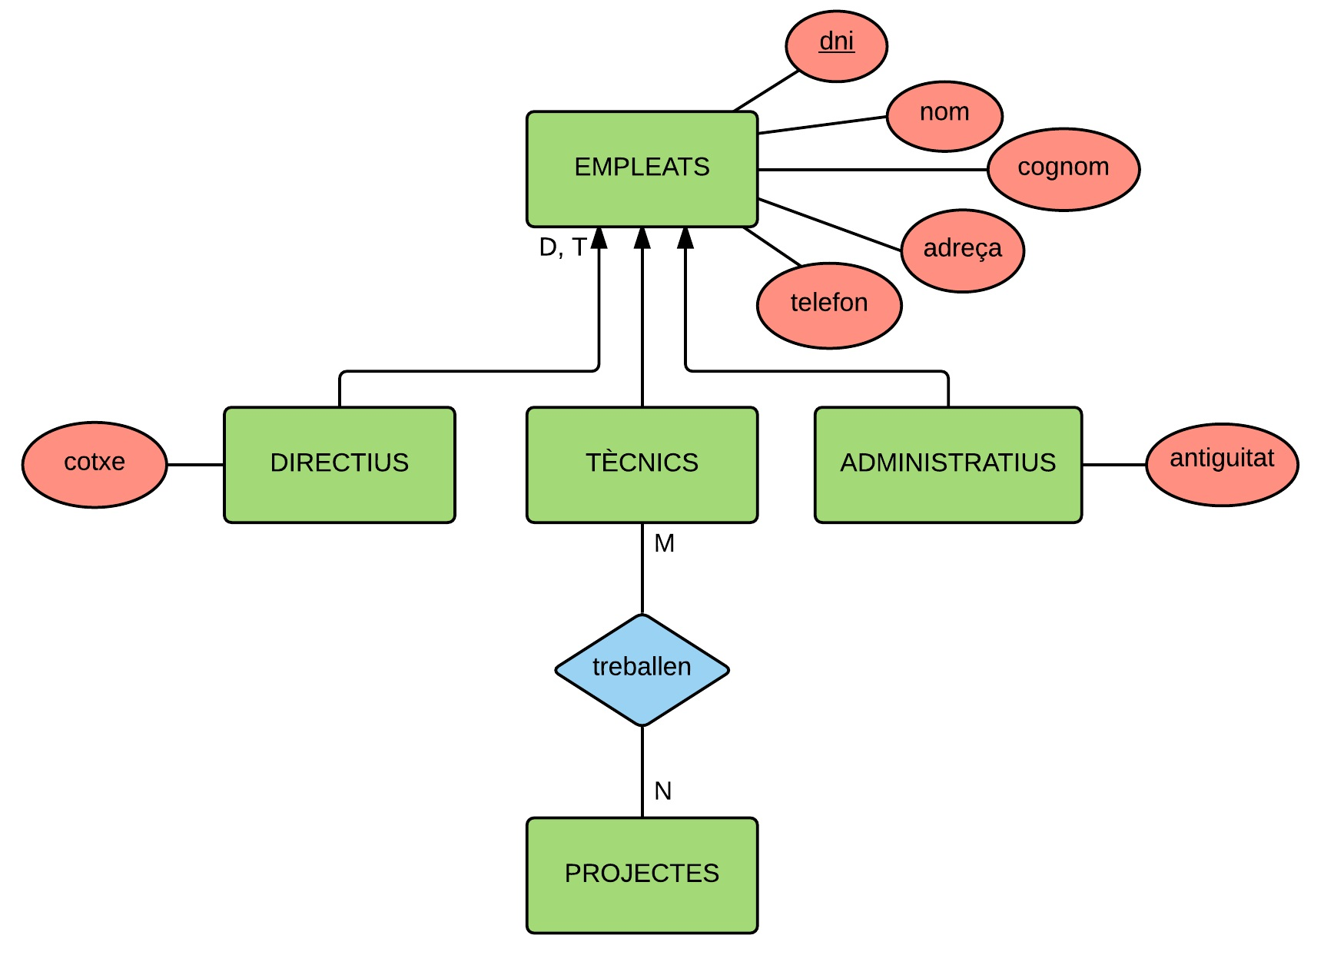
Introduction
A lot of data can be expressed in graphs

Slide 7
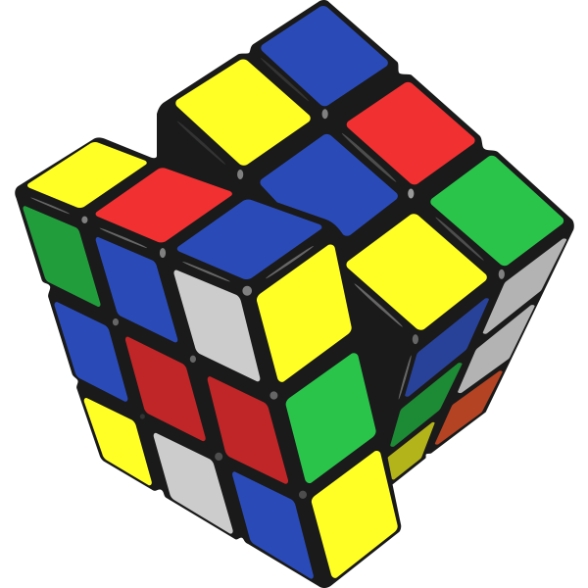
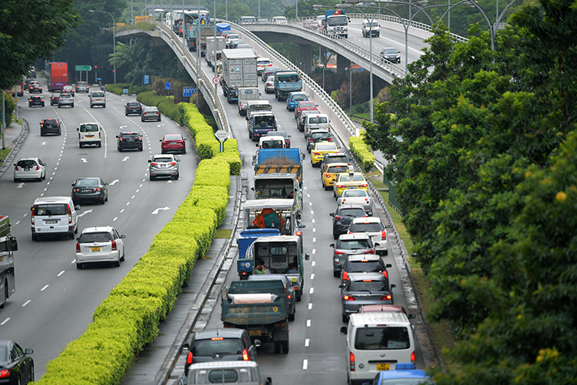

Introduction
Neural Combinatorial Optimization
Need for graph neural networks (usecase)
Traffic and Networking
Chemistry

Slide 8
Introduction
What we will be covering
Recap on ANN and implementation
Recap on Graph theory and implementation
Spatial GNNs
Different existing Architectures
Implementation of Graph Neural Networks

Slide 9



Scope (Full stack)
Machine learning and data handling with Pytorch
Graph theory with NetworkX
Graph Neural Networks with Deep Graph Library

Slide 10

All the materials
This talk will be very math-light and will not cover spectral GNNs or Graph Signal Processing or Fast GNN computation or GNN construction.

Slide 11
1
Artificial Neural Networks
Activation Functions, Neurons
2
Graph Theory
Nodes and Edges
3
Graph Neural Networks
Message Passing, GCN
4
Applications
Node, Edge and Graph Classification
ANNs
Graph Theory
Graph Neural Networks
Applications

Slide 12
Artificial Neural Networks
ANNs
Graph Theory
Graph Neural Networks
Applications

Slide 13
What is a Neural Network?
Inspired by Neural Networks in the brain
Made of multiple layers of neurons
Known as deep due to having multiple layers
…
Input
Hidden Layer
Output
ANNs
Graph Theory
Graph Neural Networks
Applications

Slide 14
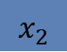
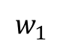
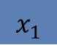
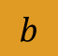
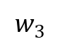
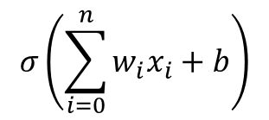
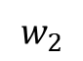
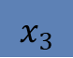
Neuron
Receives an input, processes it and produces an outputs
Connected to other neurons, with weights being the strength
Has an activation function to produce an output
$$x_{1}$$
$$w_{1}$$
Output
$$w_{2}$$
$$σ\left(\sum_{i=0}^{n}{w_{i}x_{i}}+b\right)$$
$$x_{2}$$
$$b$$
$$w_{3}$$
$$x_{3}$$
Activation function introduces non-linearity into the model
ANNs
Graph Theory
Graph Neural Networks
Applications

Slide 15
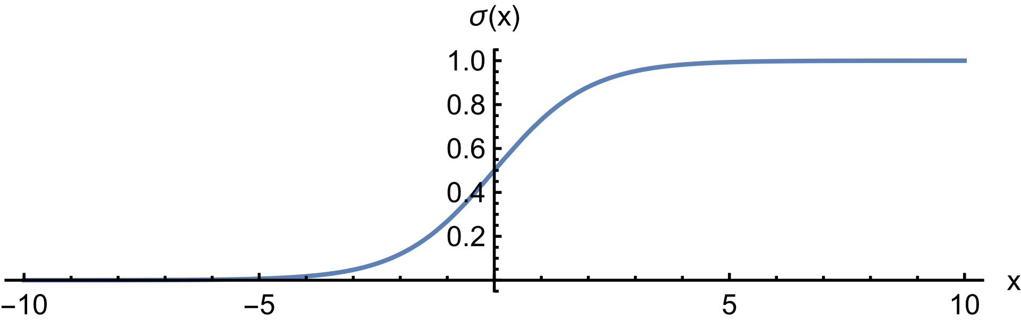
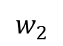
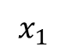
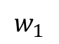
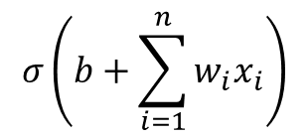
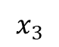
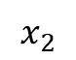
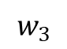
Activation Function
$$w_{1}$$
$$x_{1}$$
b
$$σ\left(b+\sum_{i=1}^{n}{w_{i}x_{i}}\right)$$
$$w_{2}$$
$$x_{2}$$
$$w_{3}$$
$$x_{3}$$
Introduce non-linearity into the system
ANNs
Graph Theory
Graph Neural Networks
Applications

Slide 16
Why do DNNs work?
Complexity
NNs have a large amount of trainable parameters which allows is to be flexible and fit a large amount of data
Non-linearity
Repeated linearity can mimic non linearity and the activation function adds more non-linear character
ANNs
ANNs
Graph Theory
Graph Theory
Graph Neural Networks
Graph Neural Networks
Applications
Applications
Notes:
Deep neural networks have the capability to handle more intricate problems and a wider range of data types due to their complexity which is due to the amount of weights and biases. However, this complexity also necessitates the use of large amounts of training data and can make training the network a challenging task. The Activation function also introduces non-linearity to the neural network that allows it to be flexible

Slide 17
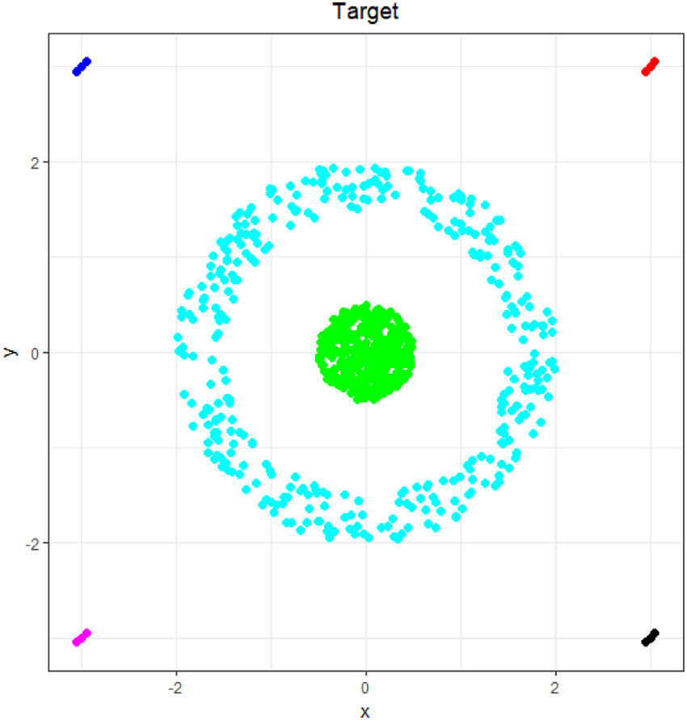
Why do DNNs work?

Slide 18
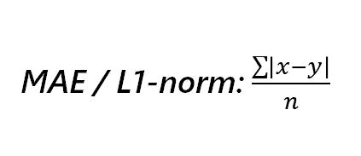
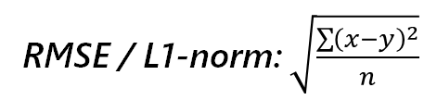
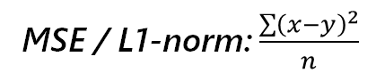
Loss Function
Describes how well / poorly the model is performing
Classification
Regression
Binary Crossentropy
MAE / L1-norm: $\frac{\sum{\left|x−y\right|}}{n}$
Categorical Crossentropy
MSE / L1-norm: $\frac{\sum{{\left(x−y\right)}^{2}}}{n}$
RMSE / L1-norm: $\sqrt{\frac{\sum{{\left(x−y\right)}^{2}}}{n}}$
ANNs
Graph Theory
Graph Neural Networks
Applications

Slide 19
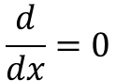
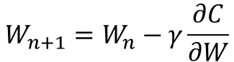
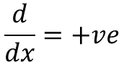
Backward Propagation
$$W_{n+1}=W_{n}−γ\frac{∂C}{∂W}$$
$$\frac{d}{dx}=+ve$$
Implies that the x-step should be to the left
$$\frac{d}{dx}=0$$
ANNs
ANNs
Graph Theory
Graph Theory
Graph Neural Networks
Graph Neural Networks
Applications
Applications
Notes:
We will be using the fact that following the gradient of an n-dimensional function will allow us to reach the local maximum. Likewise, if we go down the gradient, we find a way to go down and find the local minima, or hopefully even a global minima of the cost function for changing weights

Slide 20
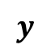
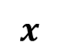
Generally
MLP
$$x$$
$$y$$
MLPs take in vectors and output vectors

Slide 21

Notebook work with PyTorch https://go.buildingblocs.sg/gnn/ann
ANNs
ANNs
Graph Theory
Graph Theory
Graph Neural Networks
Graph Neural Networks
Applications
Applications
Notes:
We will be using the fact that following the gradient of an n-dimensional function will allow us to reach the local maximum. Likewise, if we go down the gradient, we find a way to go down and find the local minima, or hopefully even a global minima of the cost function for changing weights

Slide 22
Graph Theory
ANNs
Graph Theory
Graph Neural Networks
Applications

Slide 23
What are graphs?
Graphs are mathematical structures which are used to model many relationships
ANNs
Graph Theory
Graph Neural Networks
Applications

Slide 24
What are graphs?
Elements
Connections
ANNs
Graph Theory
Graph Neural Networks
Applications

Slide 25
Just connections!

Slide 26
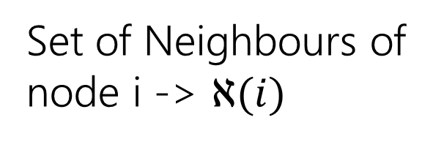
Neighbours
!
Neighbours refer to the nodes directly connected to it
Set of Neighbours of node i -> $ℵ(i)$

Slide 27
Types of Graphs
ANNs
Graph Theory
Graph Neural Networks
Applications

Slide 28
Types of Graphs
Directed
ANNs
Graph Theory
Graph Neural Networks
Applications

Slide 29
Types of Graphs
Undirected Graph
Directed Graph
ANNs
Graph Theory
Graph Neural Networks
Applications

Slide 30
Weighted graphs
Unweighted Graph
Weighted Graph
2
3
4
3
ANNs
Graph Theory
Graph Neural Networks
Applications

Slide 31
Connectivity graphs
Connected Graph
Unconnected Graph
ANNs
Graph Theory
Graph Neural Networks
Applications

Slide 32
Graph Representations
Adjacency Matrix
Used for GNN computation
Adjacency List
Used for postprocessing
Searching etc
Edge List
Used by DGL
ANNs
Graph Theory
Graph Neural Networks
Applications

Slide 33
1 2 3 4
2
2 0 0 0
4 3 2 1
2
0 3 0 0
2
0 0 2 0
1
0 0 0 1
Undirected Graph
Directed Graph
Adjacency Matrix
2
1
Matrix used to represent the graph via the connections between nodes
4
3
ANNs
Graph Theory
Graph Neural Networks
Applications

Slide 34
Undirected Graph
Directed Graph
Adjacency Matrix
1 2 3 4
2
1
4 3 2 1
4
3
ANNs
Graph Theory
Graph Neural Networks
Applications

Slide 35
Undirected Graph
Directed Graph
Adjacency Matrix
1 2 3 4
2
1
1
1
4 3 2 1
4
3
ANNs
Graph Theory
Graph Neural Networks
Applications

Slide 36
2 0 0 0
0 3 0 0
0 0 2 0
0 0 0 1
Undirected Graph
Directed Graph
Adjacency Matrix
1 2 3 4
2
1
0
1
1
0
4 3 2 1
4
1
0
1
1
1
1
0
0
3
0
1
0
0
ANNs
Graph Theory
Graph Neural Networks
Applications

Slide 37
2 0 0 0
0 3 0 0
0 0 2 0
0 0 0 1
Undirected Graph
Directed Graph
Adjacency Matrix
1 2 3 4
2
3
0
2
3
0
4 3 2 1
4
2
0
4
3
3
3
4
0
0
0
3
0
0
ANNs
Graph Theory
Graph Neural Networks
Applications

Slide 38
2 0 0 0
0 3 0 0
0 0 2 0
0 0 0 1
Undirected Graph
Directed Graph
Adjacency Matrix
1 2 3 4
2
0
1
1
0
1
4 3 2 1
0
0
1
1
4
0
0
0
0
3
0
0
0
0
ANNs
Graph Theory
Graph Neural Networks
Applications

Slide 39
2 0 0 0
0 3 0 0
0 0 2 0
0 0 0 1
Undirected Graph
Directed Graph
Adjacency List
2
1
4 3 2 1
2 | 3
4
1 | 3 | 4
1 | 3
3
2
ANNs
Graph Theory
Graph Neural Networks
Applications

Slide 40
2 0 0 0
0 3 0 0
0 0 2 0
0 0 0 1
Undirected Graph
Directed Graph
Adjacency List
2
1
4 3 2 1
2 | 3
3 | 4
4
3
ANNs
Graph Theory
Graph Neural Networks
Applications

Slide 41
2 0 0 0
0 3 0 0
0 0 2 0
0 0 0 1
Undirected Graph
Directed Graph
Edge List
2
1 | 2
1 | 3
2 | 1
2 | 3
2 | 4
3 | 1
3 | 2
4 | 2
1
4
3
ANNs
Graph Theory
Graph Neural Networks
Applications

Slide 42
2 0 0 0
0 3 0 0
0 0 2 0
0 0 0 1
Undirected Graph
Directed Graph
Edge List
2
1 | 2
1 | 3
2 | 3
2 | 4
1
4
3
ANNs
Graph Theory
Graph Neural Networks
Applications

Slide 43
Notebook work with Networkx https://go.buildingblocs.sg/gnn/networkx
ANNs
Graph Theory
Graph Neural Networks
Applications

Slide 44
Graph Neural Networks
ANNs
Graph Theory
Graph Neural Networks
Applications

Slide 45

Inductive Tasks
Examples
Molecules
Many, small graphs
Perform train, test, validation splits as per normal
ANNs
Graph Theory
Graph Neural Networks
Applications

Slide 46
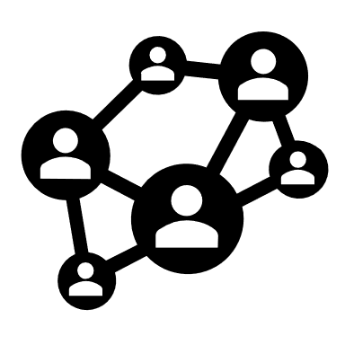
Transductive Tasks
Examples
Friendship Networks
Only one, massive graph
During training, mask parts of graph and ask for predictions
ANNs
Graph Theory
Graph Neural Networks
Applications

Slide 47
Inductive Tasks
Data Organization
One or many graphs for a given model.
Train-Test Split
Can split the training and testing set based on graphs or nodes in the graph
ANNs
Graph Theory
Graph Neural Networks
Applications

Slide 48
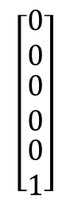
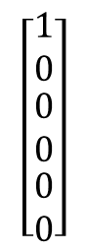
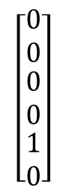
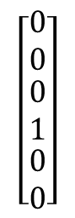
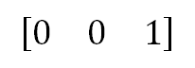
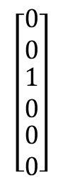
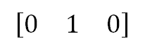
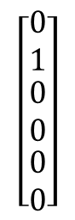
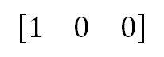
Graph Embeddings
Node Legend
$$\left[\begin{matrix}1 \\ 0 \\ \begin{matrix}0 \\ 0 \\ \begin{matrix}0 \\ 0\end{matrix}\end{matrix}\end{matrix}\right]$$
$$\left[\begin{matrix}0 \\ 1 \\ \begin{matrix}0 \\ 0 \\ \begin{matrix}0 \\ 0\end{matrix}\end{matrix}\end{matrix}\right]$$
$$\left[\begin{matrix}0 \\ 0 \\ \begin{matrix}1 \\ 0 \\ \begin{matrix}0 \\ 0\end{matrix}\end{matrix}\end{matrix}\right]$$
$$\left[\begin{matrix}0 \\ 0 \\ \begin{matrix}0 \\ 1 \\ \begin{matrix}0 \\ 0\end{matrix}\end{matrix}\end{matrix}\right]$$
$$\left[\begin{matrix}0 \\ 0 \\ \begin{matrix}0 \\ 0 \\ \begin{matrix}1 \\ 0\end{matrix}\end{matrix}\end{matrix}\right]$$
$$\left[\begin{matrix}0 \\ 0 \\ \begin{matrix}0 \\ 0 \\ \begin{matrix}0 \\ 1\end{matrix}\end{matrix}\end{matrix}\right]$$
Graph
Edge Legend
$$[\begin{matrix}1 & 0 & 0\end{matrix}]$$
$$[\begin{matrix}0 & 1 & 0\end{matrix}]$$
$$[\begin{matrix}0 & 0 & 1\end{matrix}]$$
Each node and edge must have an embedding
For classes of nodes / edge (e.g. atoms and bonds), can use one-hot encoding
ANNs
Graph Theory
Graph Neural Networks
Applications

Slide 49
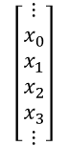
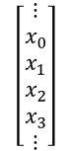
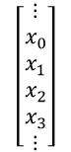
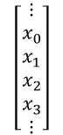
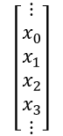
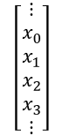
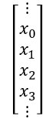
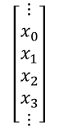

Usable Graphs
Graphs with Node and/or Edge Embeddings
$$\left[\begin{matrix}⋮ \\ x_{0} \\ x_{1} \\ x_{2} \\ x_{3} \\ ⋮\end{matrix}\right]$$
$$\left[\begin{matrix}⋮ \\ x_{0} \\ x_{1} \\ x_{2} \\ x_{3} \\ ⋮\end{matrix}\right]$$
Every node and/or every edge must have a vector associated with it. The vector must be the same size for every node or every edge. These are also known as the features.
$$\left[\begin{matrix}⋮ \\ x_{0} \\ x_{1} \\ x_{2} \\ x_{3} \\ ⋮\end{matrix}\right]$$
$$\left[\begin{matrix}⋮ \\ x_{0} \\ x_{1} \\ x_{2} \\ x_{3} \\ ⋮\end{matrix}\right]$$
$$\left[\begin{matrix}⋮ \\ x_{0} \\ x_{1} \\ x_{2} \\ x_{3} \\ ⋮\end{matrix}\right]$$
$$\left[\begin{matrix}⋮ \\ x_{0} \\ x_{1} \\ x_{2} \\ x_{3} \\ ⋮\end{matrix}\right]$$
$$\left[\begin{matrix}⋮ \\ x_{0} \\ x_{1} \\ x_{2} \\ x_{3} \\ ⋮\end{matrix}\right]$$
$$\left[\begin{matrix}⋮ \\ x_{0} \\ x_{1} \\ x_{2} \\ x_{3} \\ ⋮\end{matrix}\right]$$
$$\left[\begin{matrix}⋮ \\ x_{0} \\ x_{1} \\ x_{2} \\ x_{3} \\ ⋮\end{matrix}\right]$$
ANNs
Graph Theory
Graph Neural Networks
Applications
Notes:
Also known as the node embedding or node featues

Slide 50









Usable Graphs
Graphs with Node and/or Edge Target Embeddings
$$\left[\begin{matrix}⋮ \\ y_{0} \\ y_{1} \\ y_{2} \\ y_{3} \\ ⋮\end{matrix}\right]$$
$$\left[\begin{matrix}⋮ \\ y_{0} \\ y_{1} \\ y_{2} \\ y_{3} \\ ⋮\end{matrix}\right]$$
Every Node and/or every Edge must have another vector associated with it. The vector must be the same size for every node or every edge. These are known as the Target embeddings.
$$\left[\begin{matrix}⋮ \\ y_{0} \\ y_{1} \\ y_{2} \\ y_{3} \\ ⋮\end{matrix}\right]$$
$$\left[\begin{matrix}⋮ \\ y_{0} \\ y_{1} \\ y_{2} \\ y_{3} \\ ⋮\end{matrix}\right]$$
$$\left[\begin{matrix}⋮ \\ y_{0} \\ y_{1} \\ y_{2} \\ y_{3} \\ ⋮\end{matrix}\right]$$
$$\left[\begin{matrix}⋮ \\ y_{0} \\ y_{1} \\ y_{2} \\ y_{3} \\ ⋮\end{matrix}\right]$$
$$\left[\begin{matrix}⋮ \\ y_{0} \\ y_{1} \\ y_{2} \\ y_{3} \\ ⋮\end{matrix}\right]$$
$$\left[\begin{matrix}⋮ \\ y_{0} \\ y_{1} \\ y_{2} \\ y_{3} \\ ⋮\end{matrix}\right]$$
$$\left[\begin{matrix}⋮ \\ y_{0} \\ y_{1} \\ y_{2} \\ y_{3} \\ ⋮\end{matrix}\right]$$
ANNs
Graph Theory
Graph Neural Networks
Applications
Notes:
Also known as the node embedding or node featues

Slide 51

Usable Graph (Example)
Node features:
Population
Edge features:
Distance

Slide 52










GNN domain and range
$$h_{2}^{0}$$
$$h_{2}^{1}$$
$$h_{1}^{0}$$
$$h_{1}^{1}$$
$$h_{3}^{0}$$
$$h_{3}^{1}$$
$$h_{0}^{0}$$
$$h_{0}^{1}$$
The vectors being transformed are the node features (and sometimes edge features) of the Graph with successive GNN’s layer
$$h_{i}^{(l)}$$
The node features of the ith node on layer l
$$e_{ij}^{(l)}$$
The edge features of the edge between node i and node j on layer l

Slide 53



MLPs?
MLP
$$x$$
$$y$$
MLPs take in vectors and output vectors
MLPs fail to account for structural information
Graphs are not vectors. How do we input graphs into an MLP?
ANNs
Graph Theory
Graph Neural Networks
Applications

Slide 54
CNNs?
!
Images can be represented as graphs
Graphs are not structured like images. No “kernel” can be defined.
ANNs
Graph Theory
Graph Neural Networks
Applications

Slide 55
Building the GNN
Properties that the GNN should have
Information Sharing
Local Receptive Field
Permutation Invariance
ANNs
Graph Theory
Graph Neural Networks
Applications

Slide 56
Information sharing
Information Sharing
Information must be shared throughout the Graph

Slide 57

Receptive Field
In CNNs
Process regions of pixels instead of pixels

Slide 58

Receptive Field
Smaller Kernel
implies
Low (More local) receptive field
Larger Kernel
implies
High (More global) receptive field

Slide 59

Local receptive field
Low Probability of thunderstorm
High Probability of thunderstorm
Locality
Further away things should matter less than closer things

Slide 60
Permutation invariance
Bias
We cannot bias given nodes that are connected on a graph, when information is shared within the graph context

Slide 61
Message passing
Step 1: Neighbour Node features are transformed
Step 2: Aggregate neighbours transformed features
Step 3: Combine with the node feature
Step 4: Repeat for every node

Slide 62









Simple GNN Layer
Process embeddings without changing the connectivity of the graph
Graph
GNN Layer
$$U_{n}$$
$$V_{n}$$
$$E_{n}$$
$$f_{U_{n}}$$
$$f_{V_{n}}$$
$$f_{E_{n}}$$
$$U_{n+1}$$
$$V_{n+1}$$
$$E_{n+1}$$
Fails to account for connectivity of each node
ANNs
Graph Theory
Graph Neural Networks
Applications
Notes:
Now, let’s look at this on a higher level.

Slide 63

Message Passing
Pooling embeddings of nearby nodes and edges together
Graph
Pooling
$$ℵ_{i}$$
ANNs
Graph Theory
Graph Neural Networks
Applications

Slide 64
Message Passing
Pooling embeddings of nearby nodes and edges together
Graph
Pooling
$$ℵ_{i}$$
Apply Pooling Function
ANNs
Graph Theory
Graph Neural Networks
Applications

Slide 65
Message Passing
Pooling embeddings of nearby nodes and edges together
Graph
Pooling
$$ℵ_{i}$$
Apply Pooling Function
Combine to get new embeddings
ANNs
Graph Theory
Graph Neural Networks
Applications

Slide 66






Message Passing
Pooling embeddings of nearby nodes and edges together
GNN Layer
For a neighbourhood $ℵ_{i}$,
$$U_{n}$$
$$V_{n}$$
$$E_{n}$$
Pooling
$$m_{i}=G\left(\left\{H\left(x_{j}\right):j∈ℵ_{i}\right\}\right)$$
Update
$$h_{j}=K(m_{i},x_{i})$$
$$f_{U_{n}}$$
$$f_{V_{n}}$$
$$f_{E_{n}}$$
Exact structure of GNN layer depends on the problem being solved
$$U_{n+1}$$
$$V_{n+1}$$
$$E_{n+1}$$
ANNs
Graph Theory
Graph Neural Networks
Applications

Slide 67









Message passing
$$h_{i}^{(l+1)}=φ_{1}^{(l)}\left(h_{i}^{(l)}\right)+\sum_{j∈ℵ(i)}{φ_{2}^{(l)}\left(h_{j}^{(l)}\right)}$$
$$h_{2}^{0}$$
$$h_{2}^{1}$$
$$h_{1}^{0}$$
$$h_{1}^{1}$$
$$h_{3}^{1}$$
$$h_{3}^{0}$$
$$h_{0}^{1}$$
$$h_{0}^{0}$$
Neural Nets

Slide 68


Add edge weights
$$h_{i}^{(l+1)}=φ_{1}^{(l)}\left(h_{i}^{(l)}\right)+\sum_{j∈ℵ(i)}{φ_{2}^{(l)}\left(h_{j}^{(l)}\right)}$$
$$h_{i}^{(l+1)}=φ_{1}^{(l)}\left(h_{i}^{(l)}\right)+\sum_{j∈ℵ(i)}{e_{j,i}φ_{2}^{(l)}\left(h_{j}^{(l)}\right)}$$
ANNs
Graph Theory
Graph Neural Networks
Applications

Slide 69


Generalised GNN Layer
$$h_{i}^{(l+1)}=φ_{1}^{(l)}\left(h_{i}^{(l)}\right)+\sum_{j∈ℵ(i)}{e_{j,i}φ_{2}^{(l)}\left(h_{j}^{(l)}\right)}$$
Neural nets
Custom aggregation function
ANNs
Graph Theory
Graph Neural Networks
Applications

Slide 70
Generalised GNN Layer
Sampling
Neighbours
Aggregating Neighbors
Aggregate with node data
ANNs
Graph Theory
Graph Neural Networks
Applications

Slide 71

Info Sharing with MP
$$h_{i}^{(l+1)}=φ_{1}^{(l)}\left(h_{i}^{(l)}\right)+\sum_{j∈ℵ(i)}{e_{j,i}φ_{2}^{(l)}\left(h_{j}^{(l)}\right)}$$
Info is shared throughout each layer

Slide 72
Local Receptive Field with MP
You look at your neighbours data only per layer and so for information to diffuse you need more and more GNN layers
k = 2
k = 3
k = 1
k = 4

Slide 73
Permutation invariance
$$h_{i}^{(l+1)}=φ_{1}^{(l)}\left(h_{i}^{(l)}\right)+\sum_{j∈ℵ(i)}{e_{j,i}φ_{2}^{(l)}\left(h_{j}^{(l)}\right)}$$
Every neighbour is fed in the same neural net

Slide 74

Neural FPs
Use different weights for nodes of different degrees
GNN Layer
For a neighbourhood $ℵ_{i}$,
$$U_{n}$$
$$V_{n}$$
$$E_{n}$$
Pooling
$$m_{i}=G\left(\left\{H\left(j,x_{j}\right):j∈ℵ_{i}\right\}\right)$$
Update
$$h_{j}=K(m_{i},x_{i})$$
$$f_{U_{n}}$$
$$f_{V_{n}}$$
$$f_{E_{n}}$$
$$U_{n+1}$$
$$V_{n+1}$$
$$E_{n+1}$$
ANNs
Graph Theory
Graph Neural Networks
Applications

Slide 75


GraphSAGE
Perform pooling using learnable functions such as MLPs and LSTMs
GraphSAGE
$$x$$
k = 2
$$ρ_{k}$$
MLP
k = 3
k = 1
k = 4
Repeat with updated embeddings
$$ρ_{k}$$
MLPs
LSTMs
Pooling
ANNs
Graph Theory
Graph Neural Networks
Applications

Slide 76

Graph Attention Networks
Attention Is All You Need!
!
Neighbours are usually given equal weightage
Full Self-Attention
$$α_{ij}=a(V_{i},V_{j})$$
Use masked attention -> only computed for edges that exist
Multi-head Attention typically used
ANNs
Graph Theory
Graph Neural Networks
Applications

Slide 77
Graph Neural Network model
GNN layers
Add multiple layers to your GNN to create a GNN model
GNN Tasks
Node Classification
Standard task, just have multiple GNN layers
Edge Classification
Aggregate features of the nodes attached to the given edge and feed that through another neural net
Graph Classification
Aggregate features of all the nodes
ANNs
Graph Theory
Graph Neural Networks
Applications

Slide 78


Drawbacks -> Low params
Low Parameter Count
Low trainable parameter count. # of nodes have no effect on # of params
$$\left[\begin{matrix}x_{1} \\ x_{2} \\ x_{3}\end{matrix}\right]$$
$$\left[\begin{matrix}y_{1} \\ y_{2}\end{matrix}\right]$$
Only 8 trainable params
ANNs
Graph Theory
Graph Neural Networks
Applications

Slide 79

Drawbacks -> Oversmoothing
Oversmoothing problem
More layers actually causes there to be worse accuracy
Conventional Wisdom: “The deeper the better”
Every node becomes more similar to its neighbour with each pass, so in the end more passes cause the node features to look very similar causing a loss of contextual meaning
ANNs
Graph Theory
Graph Neural Networks
Applications

Slide 80

Drawbacks -> Bottlenecks
Graph bottlenecking
Bottlenecks -> Narrow Junctions that impedes flow
Flow of information may be impeded
ANNs
Graph Theory
Graph Neural Networks
Applications

Slide 81
Drawbacks -> Low accuracy
Low accuracy for certain tasks
Graph tasks are very complex
Graph tasks especially combinatorial optimization are very difficult. Traditional algorithms for these tasks are very slow and the GNN may take a long time to converge
ANNs
Graph Theory
Graph Neural Networks
Applications

Slide 82
Notebook work with DGL https://go.buildingblocs.sg/gnn/dgl
ANNs
Graph Theory
Graph Neural Networks
Applications

Slide 83
Real Life Applications
ANNs
Graph Theory
Graph Neural Networks
Applications

Slide 84
Real-life GNN usage
It is about leveraging the Graph Neural Nets to your advantage
More complex tasks need more complex solutions. Graph neural nets can be used to optimize these such tasks but they need to be paired with different tools to make it better
ANNs
Graph Theory
Graph Neural Networks
Applications

Slide 85

LSP with machine learning
NOI 3rd place
NOI 1st place/IOI team
BBCS ExCO

Slide 86
Goal of the project
Goal
Use machine learning to do longest simple path
Adapted Goal
Develop a method that uses machine learning to generate the longest simple path of an average graph

Slide 87
Design Thinking
Known Techniques
And restrictions
Bounds of the problem
Methodology

Slide 88

Longest simple path
Longest simple path is the longest path in the graph without repeated vertices between any 2 points in the graph

Slide 89

Longest simple path
Shortest path between 2 points, can be done very fast (time taken is proportional to sum of nodes and vertices)
Longest simple path between any 2 points, can be done deterministically very slowly (time taken is proportional to 2 to the power of edges)

Slide 90
Restrictions of the problem
Any size of graph that is
Unweighted and Undirected

Slide 91
Design thinking -> ML
Machine learning
Supervised learning
Need to generate samples with ground truth

Slide 92
Generating samples
Mersenne-twister
Generating small random graphs with Mersenne-Twister Generation
Deterministic Solver
Solving the small graphs with a deterministic solver to generate ground truth
Ground truth
We have Graph with there longest path labelled

Slide 93
Design thinking -> ML
Supervised learning
Graph task
Graph Neural Networks
What features do we need?
What kind of classification task?

Slide 94
What do we need?
Node features
How to Generate node features
We don’t have any node features on our graph, 3 common gen approach
Random Node features
Eigendecomposition of Adjacency matrix
Zero-valued Node features

Slide 95

Eigendecomposition
What is Eigen decomposition
Technique from linear algebra, any real symmetric matrix (adjacency matrix falls under this) can be split into a product of its eigenvectors and eigenvalues
Spectral representation of the graph -> node features contain contextual meaning about the graph

Slide 96
What kind of classification task?
Task determination
Pick the task specific to the problem, 3 graph tasks
Graph Classification
Edge Classification
Node Classification

Slide 97
GNN architecture
Hard to determine best architecture since task is very abstract -> Solution: test multiple architectures and see which is the best (Landed on GraphSAGE). Also tested 3,4 and 5 layer counts
GNN Layer
GNN Layer
GNN Layer

Slide 98


Final Tail process
Take the 2 node features and combine them to get the final classification on whether the Edge should be part of the LSP or not
$$\left[\begin{matrix}x_{1} \\ x_{2} \\ x_{3}\end{matrix}\right]$$
$$\left[\begin{matrix}x_{1} \\ x_{2} \\ x_{3}\end{matrix}\right]$$

Slide 99
Why cant we just use just the GNN?
GNN method
We have a full model that can predict whether an edge is part of the LSP or not why not just keep the edges it thinks are part of the LSP and discard the rest to get the LSP
There can be multiple LSPs in the graph which could leader to further inaccuracy
The model is not perfect and will probably be error prone, even if it is of a high accuracy
To pick the edges, we will have to threshold their values, which may not lead to one continuous path and may also lead to a disjoint graph

Slide 100
Design thinking -> ML
Edge classification task
Postprocessing Search

Slide 101
Idea 1 -> threshold
Threshold
Only keep edges with predicted values greater than a certain probability
Resultant graph
Graph will be much smaller and much easier to solve since less edges
Deterministic solver
Generate the longest path with the given set of edges and nodse

Slide 102
Idea 1 -> threshold
Picking a threshhold
Picking a specific threshold proved to be difficult
Disjoint problem
It was very rare, but the graph could be disjoint (made of multiple components)
Deterministic solver
A poor threshold could mean that it still takes really long

Slide 103

Idea 2 -> Best first search algorithms
Best first search
Modify a best first search algorithm for longest simple path. Biased search algorithm with some sort of heuristic to improve the speed of search. Examples include A* and IDA*

Slide 104

Idea 2 -> Beam Search
Beam Search
Every time, we look at a certain number of the neighbours of each node. Our goal is to maximise the product of the edges along the path. LSP will have maximal product

Slide 105
The entire process
Decompose it’s adjacency matrix for node features
Feed that through a graph neural network
Use beam search to get the LSP
Get edge output

Slide 106
Design thinking -> ML
Machine learning
Graph task
Supervised learning
Graph Neural Networks
Need to generate samples with ground truth
Edge classification task
Need for Node features
Search

Slide 107
Coding out this process in DGL https://go.buildingblocs.sg/gnn/lsp

Slide 108

Connect

Slide 109


Moving forward
Graph Isomorphism Network (GIN)
Do more GSP and spectral GNNs
ANNs
Graph Theory
Graph Neural Networks
Applications

Slide 110
Thank You!

Slide 111


Calculus
ANNs
Graph Theory
Graph Neural Networks
Applications

Slide 112



Matrix Calculus
ANNs
Graph Theory
Graph Neural Networks
Applications

Slide 113


Matrix Calculus
ANNs
Graph Theory
Graph Neural Networks
Applications

Slide 114
Simple Neural Network
Price
Buy Pen
Quality
Use input quantities to predict output quantity
ANNs
ANNs
Graph Theory
Graph Theory
Graph Neural Networks
Graph Neural Networks
Applications
Applications

Slide 115
0.6
Price
Buy pen
Quality
0.9
ANNs
Graph Theory
Graph Neural Networks
Applications

Slide 116
Building the GNN
Node Legend
$$\left[\begin{matrix}1 \\ 0 \\ \begin{matrix}0 \\ 0 \\ \begin{matrix}0 \\ 0\end{matrix}\end{matrix}\end{matrix}\right]$$
$$\left[\begin{matrix}0 \\ 1 \\ \begin{matrix}0 \\ 0 \\ \begin{matrix}0 \\ 0\end{matrix}\end{matrix}\end{matrix}\right]$$
$$\left[\begin{matrix}0 \\ 0 \\ \begin{matrix}1 \\ 0 \\ \begin{matrix}0 \\ 0\end{matrix}\end{matrix}\end{matrix}\right]$$
$$\left[\begin{matrix}0 \\ 0 \\ \begin{matrix}0 \\ 1 \\ \begin{matrix}0 \\ 0\end{matrix}\end{matrix}\end{matrix}\right]$$
$$\left[\begin{matrix}0 \\ 0 \\ \begin{matrix}0 \\ 0 \\ \begin{matrix}1 \\ 0\end{matrix}\end{matrix}\end{matrix}\right]$$
$$\left[\begin{matrix}0 \\ 0 \\ \begin{matrix}0 \\ 0 \\ \begin{matrix}0 \\ 1\end{matrix}\end{matrix}\end{matrix}\right]$$
Graph
Edge Legend
$$[\begin{matrix}1 & 0 & 0\end{matrix}]$$
$$[\begin{matrix}0 & 1 & 0\end{matrix}]$$
$$[\begin{matrix}0 & 0 & 1\end{matrix}]$$
Give each node and edge an initial embedding (e.g. one-hot encoding)
ANNs
Graph Theory
Graph Neural Networks
Applications

Slide 117
Building the GNN
ANNs
Graph Theory
Graph Neural Networks
Applications

Slide 118



Backward Propagation
ANNs
ANNs
Graph Theory
Graph Theory
Graph Neural Networks
Graph Neural Networks
Applications
Applications
Notes:
We will be using the fact that following the gradient of an n-dimensional function will allow us to reach the local maximum. Likewise, if we go down the gradient, we find a way to go down and find the local minima, or hopefully even a global minima of the cost function for changing weights

Slide 119


Backward Propagation
ANNs
ANNs
Graph Theory
Graph Theory
Graph Neural Networks
Graph Neural Networks
Applications
Applications

